Slide 1
P4XT Transponder Project Phase One System Design Review Workshop
Open Research Institute
WU1Y (Wally Ritchie) - 30 July 2020
Notes:
Welcome!. I’m Wally Ritchie, WU1Y, and today we are going to run through the slides from the System Design Review Workshop from July 30, 2020. This workshop reviewed and discussed the baseline design for the P4XT Transponder Project Phase One Program. This workshop was an extension of a 4 hour face to face workshop conducting following Hamcation in Orlando back in February. A recording of that workshop is available on the ORI website.

Slide 2
Who Are We
Phase 4 Ground (P4G)
Open Source Project to design ground equipment for the Phase 4B Satellite.
Established in April 2015
Initially an informal AMSAT effort.
Open Research Institute
Non-Profit 501c3 Corporation formed in Feb 2018
Hosts Phase 4 Ground and Phase 4 Space projects
Advocates Open Hardware and Software and Publicly available technical data falling under the ITAR “Public Domain” carve out.
Refer to:
https://openresearch.institute/itar-and-ear-strategy/
Notes:
So who are we?
The Phase 4 Ground or “P4G” began in 2015 started by Michelle Thompson and others. The goal was to develop open source microwave ground equipment for the Phase 4B GEO Satellite. The space based transponder was to be a rideshare payload aboard a US Air Force experimental satellite. The Air Force project was delayed an eventually cancelled. But the Phase 4 Ground work continued.
P4 Ground started as an informal AMSAT NA effort. In 2018, Open Research Institute was founded as a 501c3 non-profit. The P4G project is now hosted by ORI along with Phase 4 Space and other open source projects. P4 Ground has produced a lot useful code and FPGA pieces – all of which are open.
Satellite projects in the United States normally must deal with ITAR, the International Trafficking in Arms Regulations. Phase 4 Ground was organized so that the ground station development activities could remain open and freely available to all from the start and becoming entangled in ITAR. The open concept has been extended to space components. ORI Maintains ITAR and EAR Strategies and Policies to ensure that all work is public and falls under the “Public Domain” carve outs in ITAR.

Slide 3
What is P4XT
Phase 4 ‘X’ Transponder
Phase 4 coined by AMSAT orgs to refer to GEO.
Deliver Designs for:
Space Based Digital Multiplexed Transponder P4XDMT
Low Cost Earth Station Model P4XM
Formal ORI Research & Development Project
All Volunteer Engineering Resources
Global Amateur Radio Community
Open Source Global Satellite Community
Funded Tools, Equipment, and Hardware
$50,000 Phase I (committed)
$500,000 Phase II (in process)
Notes:
P4XT is our transponder project. P4 or Phase 4 refers to GEO satellites. X indicates it applies to any future GEO satellite – not a particular satellite.
The project goals are to deliver a Digital Multiplexed Transponder which we call – P4XDMT. It will also project a companion modem for use in low cost earth stations.
P4XT is now a format ORI R&D Project. The project is based on the idea that major engineering projects can be accomplished with volunteer engineers who are leveraged by funding for the Tools, Equipment, and Hardware needed to accomplish a complex FPGA based project. The project funding levels are $50K for Phase I that is already committed. Phase II is expected to required $500K and fundraising is already underway. These budgets fund tools, equipment, and hardware – not engineering labor. The engineering labor efforts would require millions of dollars in traditional commercial or military settings.
Volunteer Engineering Resources come from the Global Amateur Radio Community and the global Open Source Satellite Community as well as other open source communities.

Slide 4
PROJECT GOALS
GEO TRANSPONDER (P4XDMT)
All Digital Design to final IF
Fully Verified and Validated Design
Ready for Final Adaption for Specific Space (and Ground) Missions
LOW-COST MODEM (P4XM)
Core of low-cost Earth Station Terminal
Full High-Performance DVB-S2 Receiver
GPS Derived Reference and station clock
Standalone Operation (no separate PC required)
L-BAND IF Inputs and Outputs
< US$ 250 Target Cost
Notes:
So the project goals are two parts. The first is to produce the transponder design. This is ann digital design to IF. Analog is used only in final conversions to and from microwave RF. The design is mostly software and FPGA code. FPGA code is Verilog or VHDL and timing specifications. These are glued to standard FPGA building blocks like FIFO memories. All this open source that will be fully verified and validated. The goal is to have the pieces needed to support a specific mission and they will all be demonstrated on suitable hardware. Specific projects will only need to adapt to their specific mission requirements.
A GEO based comm system requires earth stations. The goal of this project is to serve the broad amateur community. This requires a low cost easy to install earth station. The heart of that station is the low-cost modem. This will have full high-performance DVB-S2 receiver for the downlink and a GPS Derived Station Clock. It will operate standalone without requiring a separate PC. The inputs and outputs will be L-Band and suitable for use with low-cost LNB’s and BUC’s. The cost target is less than US$250

Slide 5
WHY DO THIS?
There is No ready to Fly Transponder Payload
Analog Bent Pipe Transponders have Shortcomings
Inefficient use of bandwidth
Subject to unauthorized hi-jacking
Interference
Reliable Amateur Satellite Disaster Capability is virtually non-existent
Paper Designs and Demos are Not enough
RADIO ARTS ARE NOW >95% Digital
HUGE EDUCATIONAL OPPORTUNITIES
Notes:
So Why are we doing this?
First, there is no ready to Fly GEO Transponder Payload. If we had an opportunity for a rideshare this year – we have nothing ready to fly – nothing even close.
Analog Bent Pipe Transponders have shortcomings. These include inefficient use of bandwidth, vulnerability to hi-jacking, and many interference issues associated with sharing. These can all be eliminated with an all digital design.
The amateur Radio Satellite community has no reliable EMCOMM capability. A GEO with 24/7 accessible can change that.
Paper Designs and GNU Radio Demos and are very valuable pieces. But they are not enough. To have a realistic shot at a GEO launch opportunity demonstration of real capability is required.
The Radio Arts are now more than 95% digital. The advantages are just too great. There are huge education opportunities associated with digital comms.

Slide 6
USE CASES
SPACE
Hosted Repeater Payload on GEO Rideshare
COMM Repeater Payload for future dedicated 6U Geo Cubesat (P4 Space)
COMM Payload for ARISS/GATEWAY Missions
COMM Payload for ARISS/ISS Demonstrations
COMM Payload for LEO Missions
GROUND
QO-100 Ground Based Digital Multiplexed Repeater
Local Digital Repeaters
DSES 18M Dish Astronomical Receiver
DSES 18M Dish Deep Space COMM Transceiver
OTHER
Airborne Packages (Aircraft, Balloons, Sounding Rockets)
????????
Notes:
So what will we do with this DMT.
In Space, our primary use case is the digital repeater. This will provide a comm capability for hundreds and thousands of Ham users. The first of these repeater is most likely to be a rideshare on some GEO mission.
The DMT can be a payload for a dedicated 6U GEO Cubesat. Designs for this are being explored in P4 Space.
The DMT could also be a suitable payload for ARIXX/GATEWAY missions. It could provide video and data downlinks and support ARISS style school contacts. It might also serve as data relay for Lunar Missions.
The DMT might be suitable for ARISS/ISS missions – perhaps as demos for future Gateway capabilities.
Finally, the DMT can be the COMM payload for various LEO missions, typically 3U and up – but possibly even 1U’s under suitable conditions.
On the ground, we would like to demonstrate the complete DMT system running through the space segments of QO-100. As we’ll discuss later, the DMT would be on the ground. There would be two hops through the satellite doubling delays and doubling paths. But the full hardware and software would be demonstrable – both the DMT and the Modems. These could even become a permanent feature of QO-100 if its operator so chose.
The DMT will also be suitable for use as an astronomical receiver. This is of interest to the Deep Space Exploration Society for use with its 18M Dish. It could also be used for two-way comms through the 18M Dish providing an all amateur capability.
Finally, there are many other possible uses where high data rates are required.

Slide 7
Project Phases
Phase I (Feasibility Demonstration Prototype)
Demonstrate Functional Hardware/RTL/Software
Fully Functional DVB-S2 Transmitter Chain in RTL
Remote Development Tool Chains
Verification and Validation Framework
Definition of Phase II
Phase II (Fully Functional Prototypes)
Fully Functional DMT
Multi-Channel Receivers
Wideband and Narrowband Multiplexers
Authentication/Authorization/Allocation
DVB-S2 VCM
Over-the-air Reconfiguration
Ground Based Repeater (QO-100)
Phase III (Space Deployments)
ARISS/GATEWAY
6U GEO
Partner Projects
Notes:
So our overall project is organized into three Phases. These are traditional Military/Government Phase definitions.
Phase I is our feasibility demonstration. We will be fully functional hardware, RTL and Software including the fully functional DVB-S2 transmitter chain. This will give us a change to prove out remote development tool chains and frameworks for verification and validation that we can use through the full project. During Phase I we will also produce the complete definition for Phase II.
Phase II will essentially expand the Phase I effort to complete the entire package. This will add the multi-channel receivers, Wideband and Narrowband Multiplexers, AAA protocols and other stuff. Toward the latter stages of Phase II we expect to deploy the Ground Based Repeater configuration for QO-100. This will provide an all-up test of the DMT and ground equipment.
Phase III will involve the actual Space Deployments. They could be ARISS or a Phase 4 Space 6U or other projects. Phase III’s will be able to incorporate any or all the Phase II pieces. They could make use of the hardware demonstration platforms as is or further adapt them to a specific mission.

Slide 8
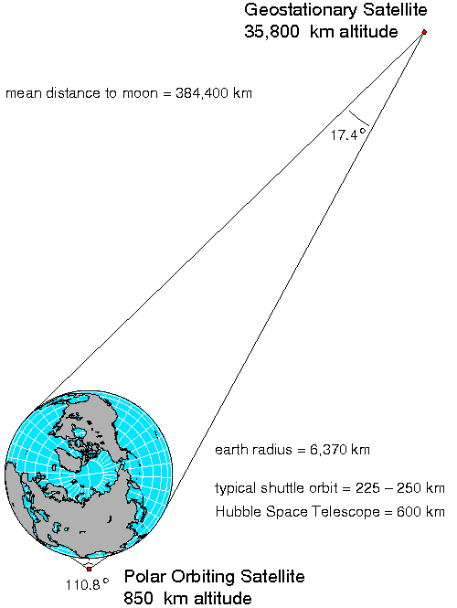
GEOMETRY
Notes:
Most people on this call are already familiar with GEO. Not everyone has a good feel for the different between GEO and LEO satellites. Graphics are not usually to scale. This slide show the actual scale. LEO satellites and Polar Orbit satellites are very close to the globe. The GEO’s are 36 kilometers away. The moon is 4 feet to the right. From GEO, the earth is only about 17.5 degrees in the field of view.

Slide 9
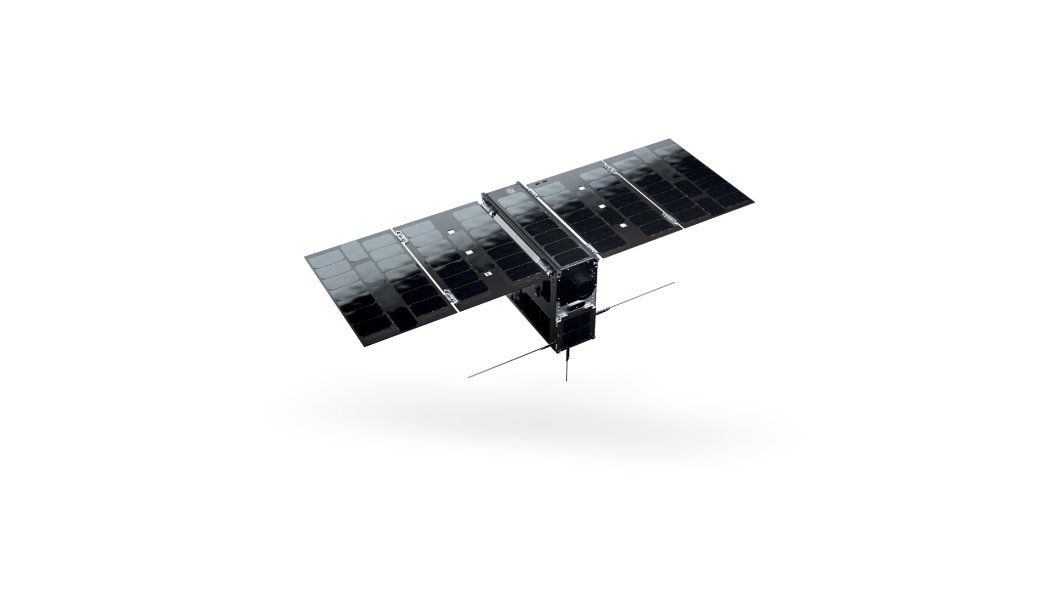

6U CUBESAT
Notes:
From GEO, the earth looks like this compared to the moon.

Slide 10
6U Cubesat (100mm x 200mm x 300mm)
Notes:
This is an AAC Cylde Space EPIC 6U Platform. It shows the rough configuration of a typical 6U Cubesat.

Slide 11
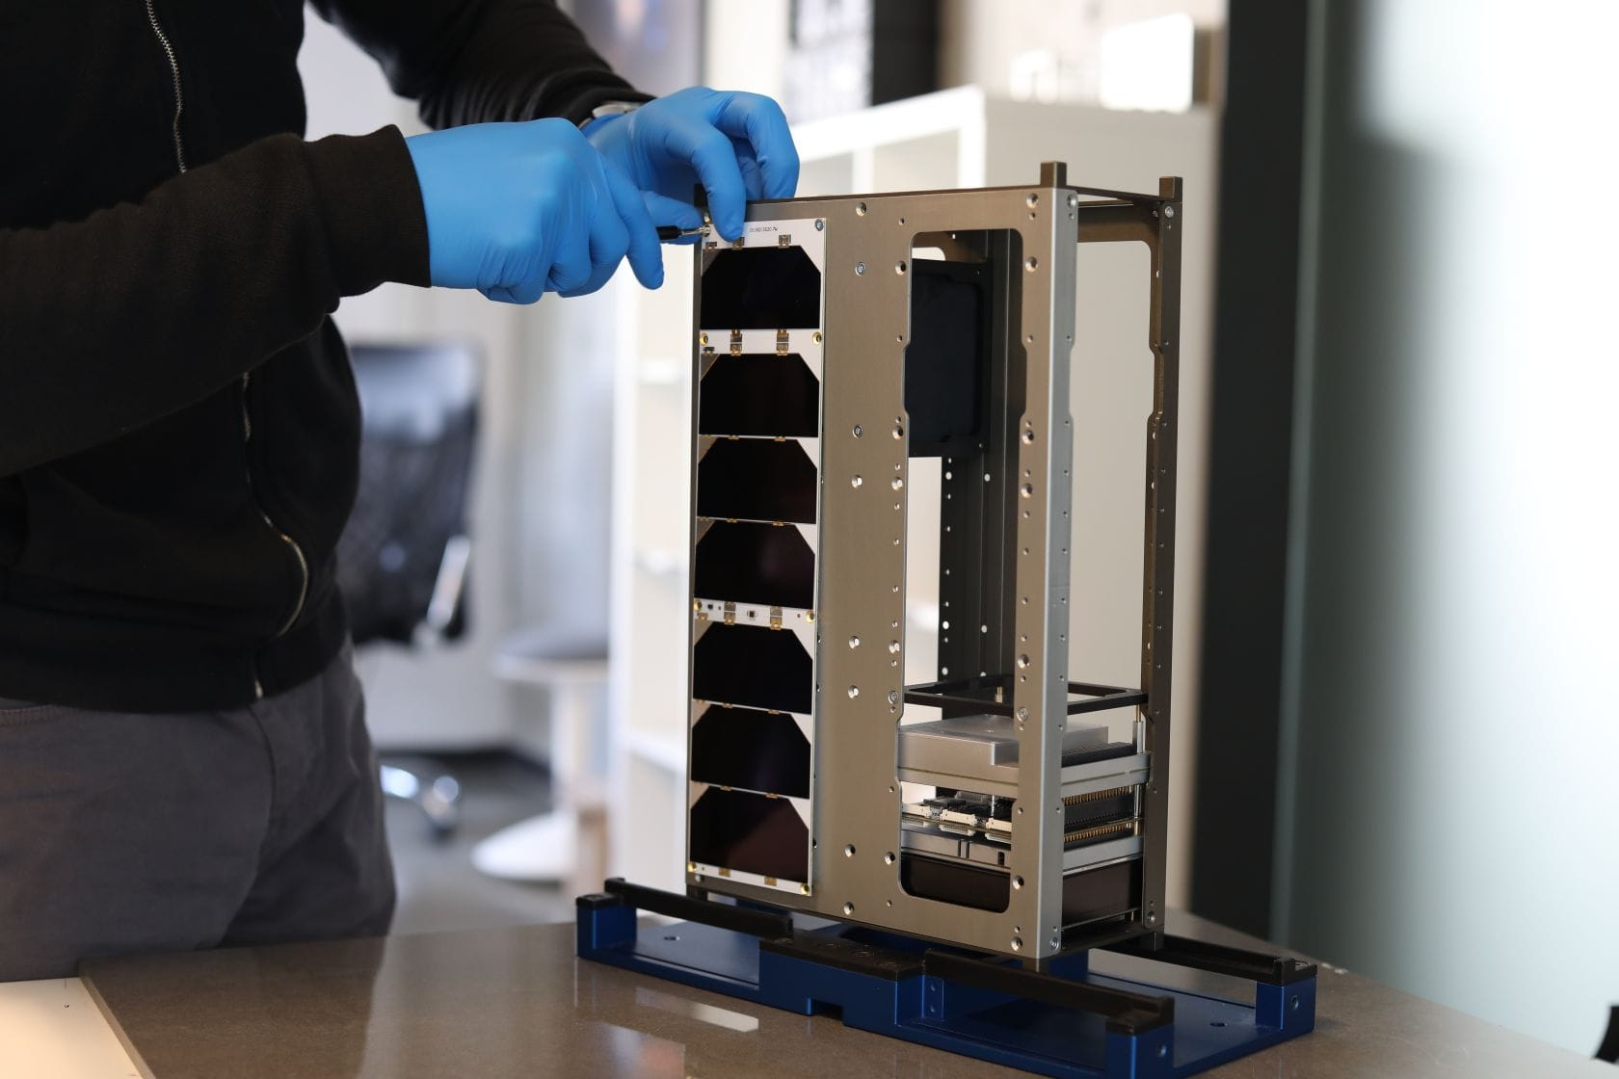
6U Package (Endurosat)
Notes:
To give an idea of scale, this is a 6U box. As you can see its not very big. The mass in on the order of 10 – 12 kg.

Slide 12
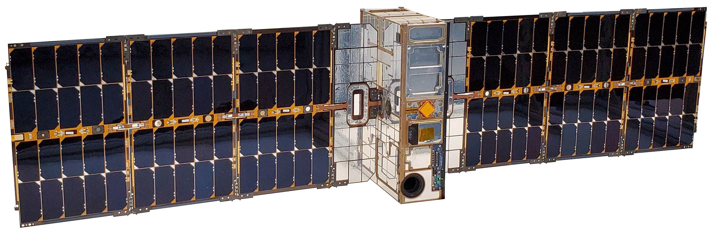
6U 120W Peak Power Solar Array
Notes:
6U Cubesat power can reach the 100W range. Most cubesats with this much power will need radiators as well to off-load the dissipated power that isn’t radiated as RF.

Slide 13
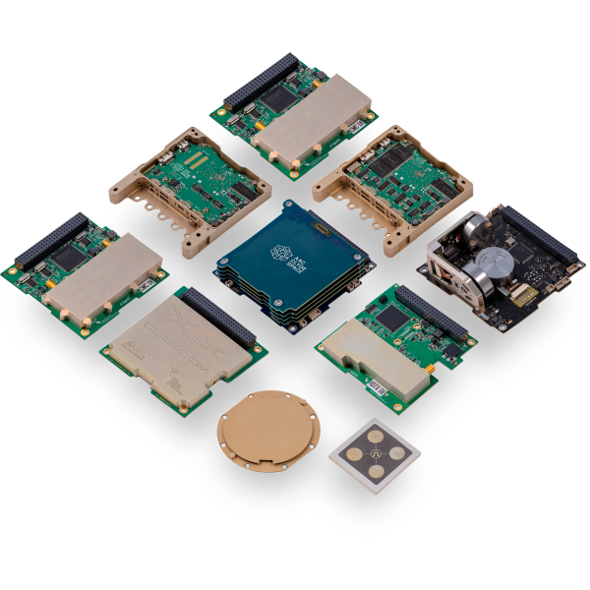
Cubesat Bits
Notes:
Cubesat electronics is typically packaged on PC-104 sized boards. 6U packages have a lot more flexibility but 90mm x 90mm are a convenient size to work with.

Slide 14
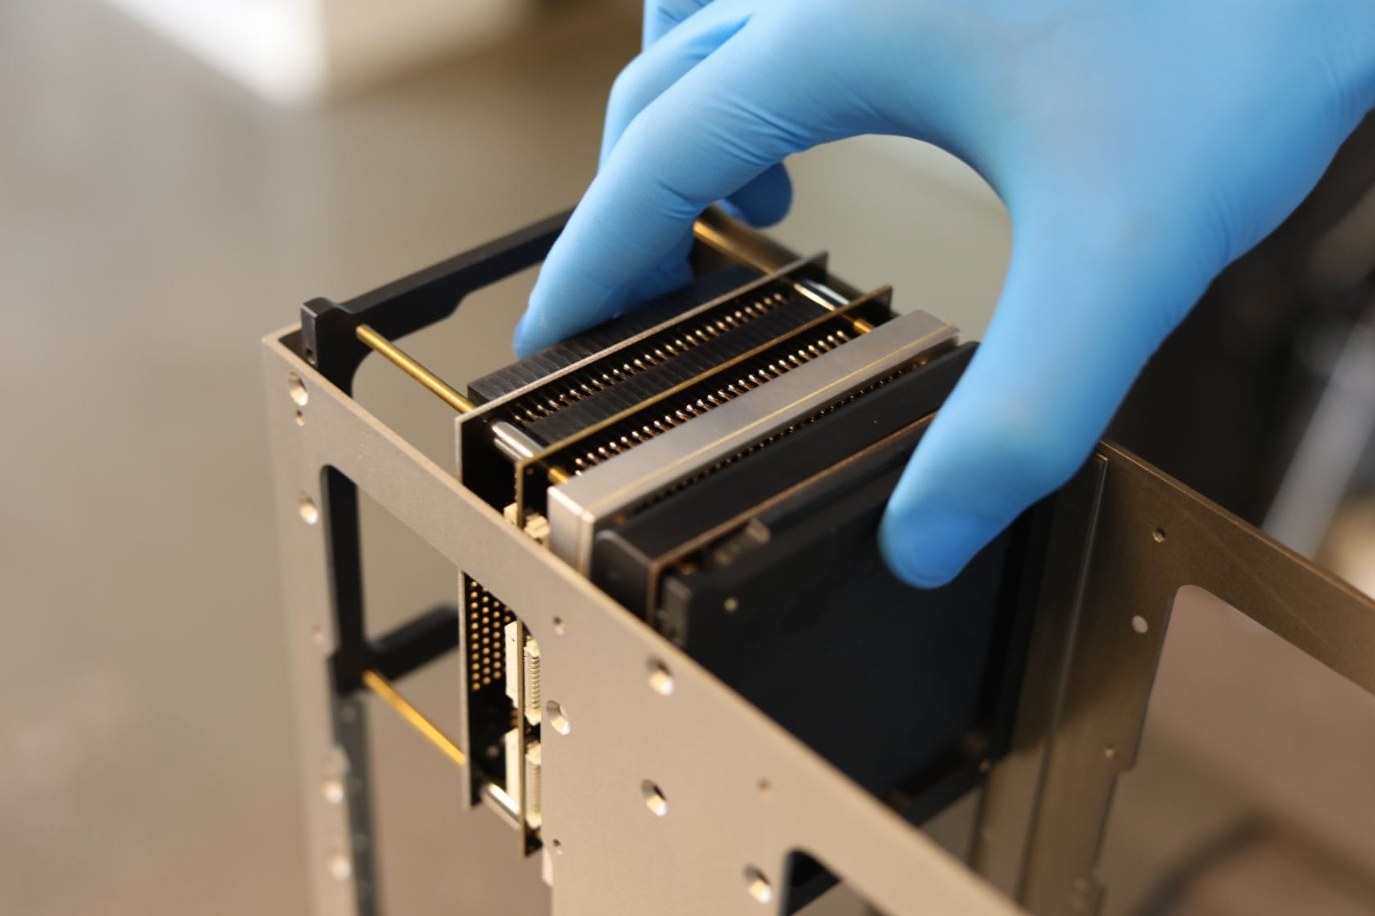
Cubesat Bus Card Stack
Notes:
This slide gives an idea of a board stack within a typical 6U. This is about the volume we’re talking about for the complete transponder.

Slide 15
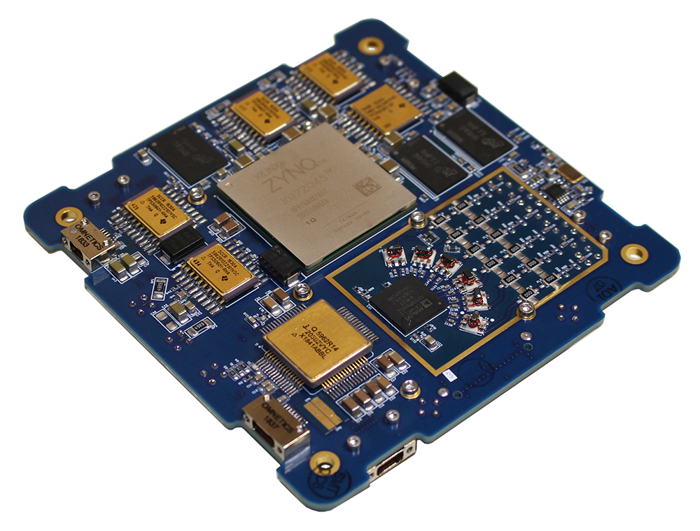
RINCON AstroSDR
Notes:
The cancelled P4 Project was planning to use a RINCOM AstroSDR. This is a more-or-less off the shelf FPGA and 9361 based radio. This design used Cubesat Next Generation Bus (CNGB) connectors. This platform was based on a Xilinx first generation Zynq platform with a parallel digital radio interface.

Slide 16
Repeater Use Cases
Provide 24/7 “Ham” User Experience
Random P2P Communication (CQ, QSO)
One to Many Communication
Rag Chews
Net Operations (Southcars, etc)
NTS Traffic Handling
EMCOMM Communications
Special Event Support
Appliance Like Operation for Mass Adoption
As Homebrew roll-your-own as you want to be
MODES
Classic PTT Voice and Digital (and both at same time)
Zoom-Like Conferencing (presenter + N participants)
Voice and text Messaging
Live Video
Radio Arts Experimentation
Notes:
So What you do with a DMT as a repeater?
We are looking to provide a system that can be widely used by ordinary Hams. So we want to provide as a baseline a traditional Ham Experience. That means random Point to Point communications. Calling or Answering a ‘CQ’ having a random QSO.
We also want to support traditional One to Many communications. Rag Chews. Net Operations like Southcars. NTS traffic nets. Emergency Communications and Special Events.
For Mass adoption we simple “Appliance Like” Operation and simple installation. Pointing a Dish. Not much more.
But – we want to enable Hams to Homebrew to their hearts content. Roll their own either pieces like Block Upconverters, Feeds, Dishes, and Accessories as well experimentation in the software.
While the DMT is essentially fully digital it’s delivered modes are classic Push to Talk Voice and traditional digital messaging. RTTY equivalents. Both will be possible at the same time.
Covid has widely expanding the public familiarity with Zoom-Like Conferencing. We can do this through the DMT. Probably not everyone with video but the capability for voice, video presentation from one or more presenters, static images for everyone, and similar features.
Live Video will also be possible with stations capable of wideband transmissions.
We have received comments during our live presentations regarding the loss of analog experimentation in an all digital design. At our Hamcation workshop we kicked this around a bit and we think we have a Virtual Analog Channel concept that will work for this.

Slide 17
Virtual Analog Channels
Supports Experimentation with new Analog and Digital Modes over GEO space segment uplinks.
Received IQ Baseband Forwarding over DVB-S2 Downlink.
1X, 2X and 4X Oversampling – 16/24-bit A/D
200 - 1200 kbps realtime IQ stream
2048 – 8192 bps PSD (8 bit log)
Realtime or Stored and Forwarded
6.25kHz, 12.5kHz, or 25kHz Channels
Full Adjacent Channel Guard bands
Channel Reservation Required
AAA Still Required using standard channel protocols
Fixed Gain or AGC
Channel Instrumentation (SA, RSSI, etc)
Supported by Low-Cost Modem
Notes:
With our digital downlink we have lots of capacity and we’re not even thinking about analog for that. However, on the uplink we can receive anything. Instead of decoding a digital modulation for forwarded, we can just forward along the raw IQ data streams. Since we have lots of downlink bandwidth – the inefficiency in this is not a problem.
This allows user to experience with any uplink analog signals in an allocated bandwidth and process them from the digital baseband. It’s not much different than passing a sampled piece of spectrum in an SDR.
The capable here could be 16/24 bit A/D with various oversampling. This amounts to on the order of megabit of digital IQ stream. We can also provide a Power Spectral Density stream providing a virtual spectrum analyzer.
The data can be passed in realtime – or stored and relayed at a lower rate. Channel bandwidths would be similar to our standard uplink channels and we would likely provide guard bands on both side to minimize interference.
The Authentication, Authorization, and Allocation protocols would be used to negotiate these channels. Our goal will be to provide this capability in the low cost modem.

Slide 18
QO-100 Ground Based Repeater
2.4 GHz
10.5 GHz
Notes:
When we get to Phase II we will be looking at deploying the DMT as a ground based repeater for testing through QO-100. In this configuration the transponder is not in the satellite. The satellite has a bent pipe analog transponder with 2.4 GHz uplink and 10.5 GHz downlink. QO-100 has both narrow 500 kHz band and wide 8 MHz transponders.
Today, hams in Europe and Africa use the narrowband for mostly SSB with transverters. The wideband is used for experimenting with Amateur TV.
In the Ground Based DMT concept, we would deploy the DMT at a large earth station in the coverage area. It would receive the narrowband signals – just like a space based DMT. But the signals will travel both up and down to reach the DMT. We would transfer the usual DVB-S2 downlink by uplinking through the bent pipe transponder.
The users on the ground would see essentially the same operation as the will with a space based DMT except for the doubled delays. The narrow band uplinks could use either transponder. Probably the narrowband transponder for initial tests.
This configuration would provide a real life all-up testbed and demonstration. It wouldn’t have all of the advantages of a DMT in space – primary the hacker resistance. But it can demonstrate most of the other advantages and prove out both the DMT and the modems.

Slide 19
Repeater Mode Advantages
Only DVB-S2 Receiver Required. (No need for existing transceiver and transverter)
Simple Digital Transmitter on 2.4GHz uplink, 2W
Digital Voice
Expensive Equipment only at Central Station
Coexistence with Analog Modes
Notes:
A QO-100 Repeater Based system has a number of advantages.
First, Only the DVB-S2 receiver is required. There is no need for a transceiver or transverter.
Second, the digital transmitter on 2.4GHz can be low power – well under 2W.
All the Voice would be Digital. QO-100 already provides very good SSB because the channels are non-fading. But Digital voice will still be much better than that.
The expensive equipment will only be at the Central Station. These will need larger dish, higher power, and the DMT. But only one or two of these are needed.
All of this can work without impacting any of the analog modes.

Slide 20
Why DVB-S2
DVB Standards are International, Free, and very widely used.
DVB-S2 is the 2nd Generation Standard
Generic Stream Encapsulation (GSE) used for the downlink data.
QUASI Error Free (QEF) Downlink
Variable Coding and Modulation
Notes:
So Why are we using the DVB-S2
First, the DVB Standards are International, Fee and very widely used. The technology is in use in 100’s of millions of receivers.
DVB-S2 is the 2nd generation standard. It’s already gained a lot of acceptance and displaced much of the first generation.
DVB-S2 has a nice Generic Stream Encapsulation for downlink data. We are not using the normal DVB-S2 MPEG Transport Streams. So we build on the standard GSE capabilities. This can range from raw generic streams to IP traffic.
DVB-S2 provides Quasi Error Free (QEF) Downlinks. The errors are so low they can be ignored. The link either work or not.
DVB-S2 has a very flexible variable Coding and Modulation that covers a 20dB range of C/N ratios.

Slide 21
DVB-S2 Features
Continuous Transmission of frames at fixed symbol rate.
Modulation and Coding (MODCOD) can vary with each frame.
Linear and Non-linear Modulations
QPSK/8PSK
16APSK/32APSK
Addition Modulations with DVB-S2X
Very Powerful Forward Error Correction (FEC) LDPC+BCH
Notes:
In DVB-S2 frames are transmitted continuously at a fixed symbol rate. Standard Television normally uses symbol rates on the order of 30MBaud in traditional 36MHz transponder channels with 40 MHz spacing. We will be using symbol rates up to 8 Mbaud.
With DVB-S2 each frame can have a different modulation and coding for the frame. All stations can receive the preamble and determine the size and coding for the frame, whether or not they have the ability to receive that type of frame.
DVB-S2 support both Linear and Non-Linear Modulations. In addition to traditional QPSK/8PSK, it has modulations of 16APSK/32APSK.
DVB-S2 has additional modulations available with it’s well defined extensions in DVB-S2X.
DVB-S2 has a very powerful Forward Error Correction based on LDPC and BCH codes.

Slide 22
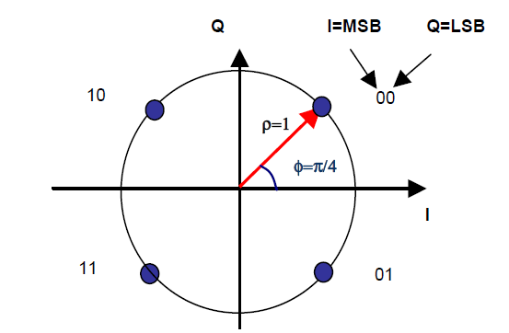
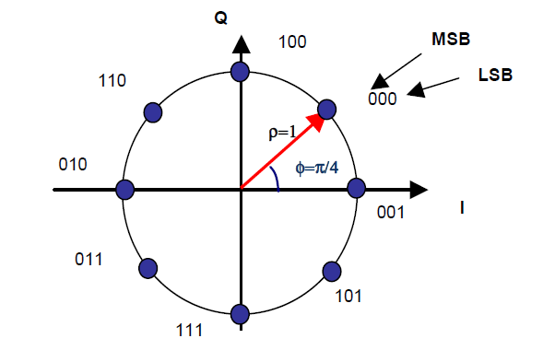
Constellation Mapping Non-Linear Modulations
QPSK
8PSK
Notes:
DVB-S2 Non-Linear Modulations or constant envelope modulations include QPSK and 8PSK.
These modulations can work well with saturated output stages which have higher DC Power efficiency. This is important when power is limited.

Slide 23
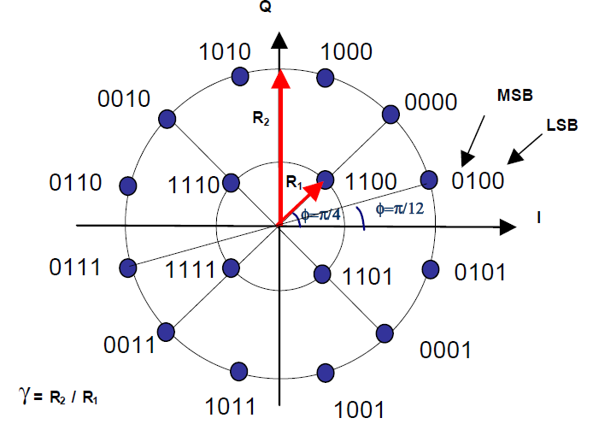
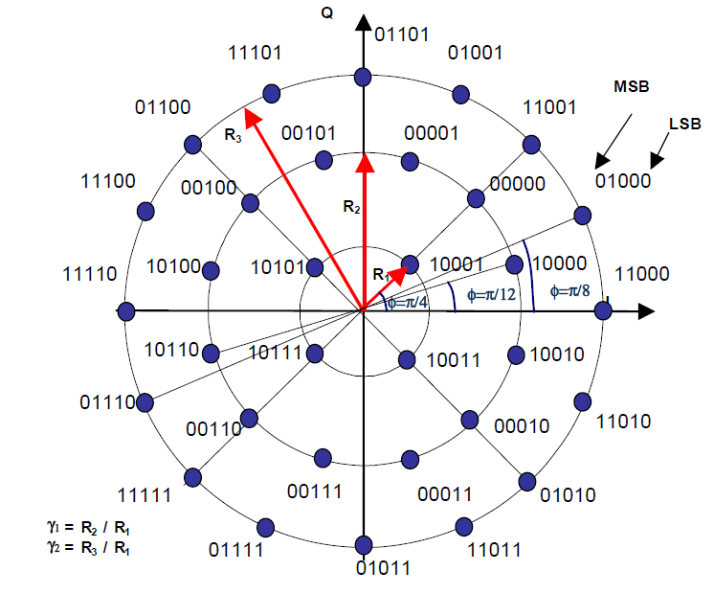
Linear Modulations Mapping
16 APSK
32 APSK
Notes:
The linear modulations can higher bit efficiencies when the transmitters are linear and the C/N’s are high enough. They can allow stations with larger dishes to receive higher data rates. There is a lot of room for research and experimentation in this area where pre-distortion and other techniques can be used to obtain adequate performance from quasi linear transmitters.

Slide 24
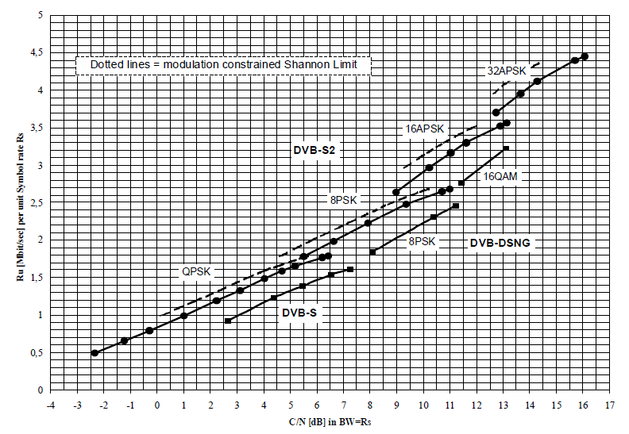
DVB-S2 Performance
Notes:
DVB-S2 achieves performance very close to the limits of information theory. On this chart the theoretical Shannon Limits for various modulations in an AWGN channel shown by the dotted lines. The performance of DVB-S2 are shown by the solid lines close to the limits. DVB-S is shown for reference. Performance is around ½ dB from the theoretical limits.
The main takeaway from this is that it doesn’t get significantly better than this.

Slide 25
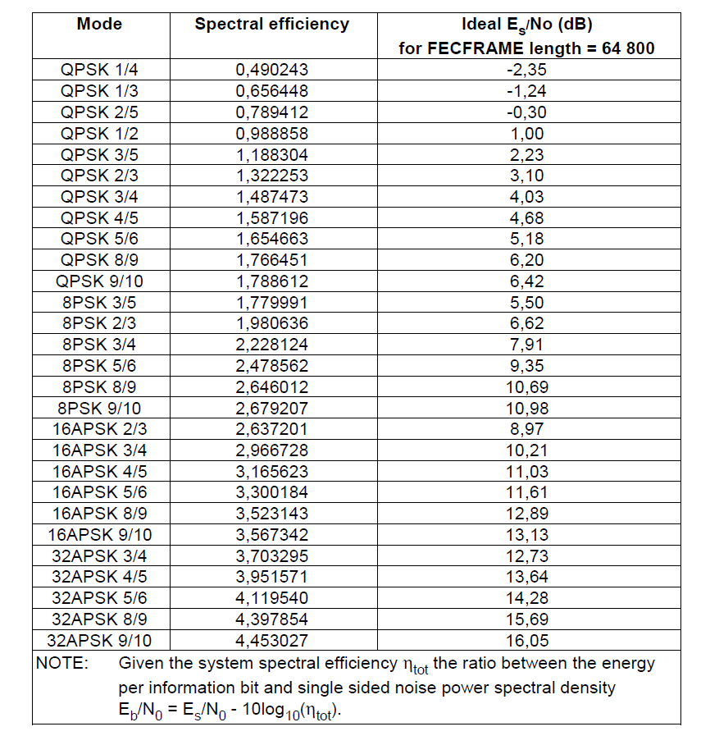
DVB-S2 Performance
Notes:
The performance is tabulated in this chart. This can be found in the DVB-S2 specs and guidelines.

Slide 26
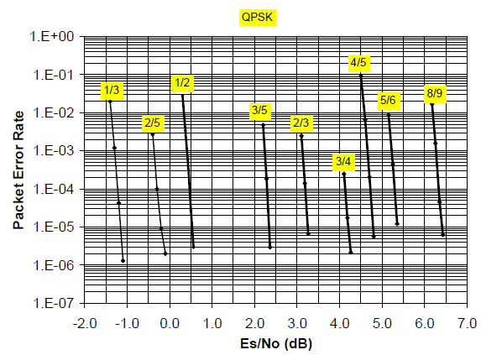
Es/No vs Packet Error Rates
Notes:
Because of the performance, the Es/No required for various frame error rates are very sharp curves. There is only about 1dB between Quasi Error Free and 5% to 10% frame errors. So it either works or not in AWGN channels.

Slide 27
P4XT Downlink
10.455 (typ) GHz Carrier
Single Digital Downlink Carrier
Saturated Power Amplifier (maximize DC efficiency)
Up to 8+ MSPS
DVB-S2 QPSK/8PSK Modulation
ALL Stations synchronize to the downlink
Stations Decode streams they want (including all streams if capable)
Notes:
Summarizing Our DVB-S2 Downlinks:
They will typically be 10 GHz – although in some cases they could be 24GHz.
They are Single Carrier – originated in the transmitter – Not Multiple carriers in a bent pipe bandwidth.
Saturated Final Amplifiers can be used to maximize the DC Efficiency.
They will support up to 8 Mbaud with a low on the order of 80kilobaud
The most common modulation will be QPSK/8PSK with APSK with linear power amplifiers.
All stations synchronize the downlink and follow frame by frame.
Stations decode the streams they want and are capable of receiving (based on C/N).

Slide 28
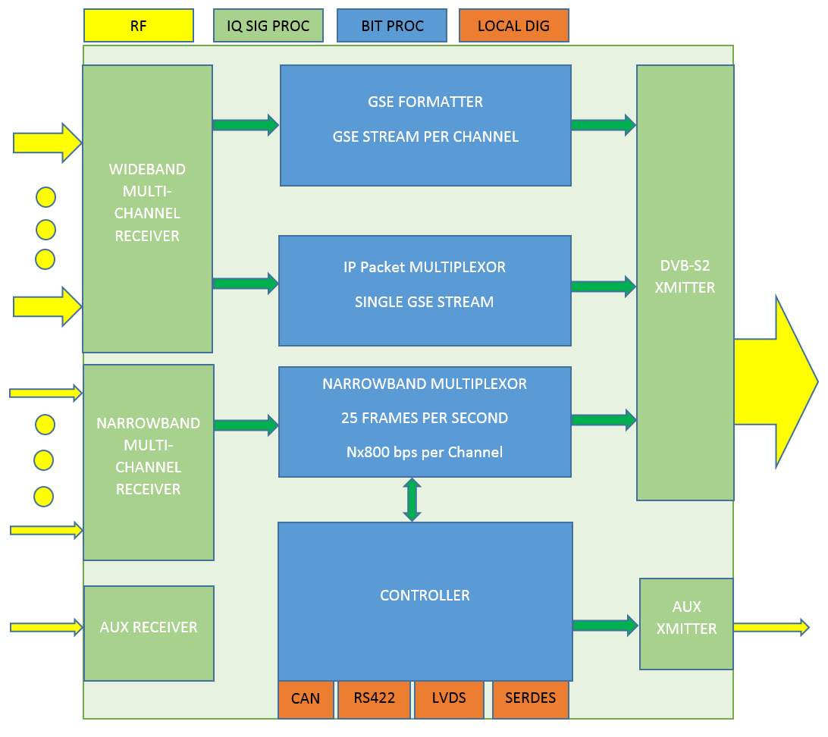
Logical Architecture

Slide 29
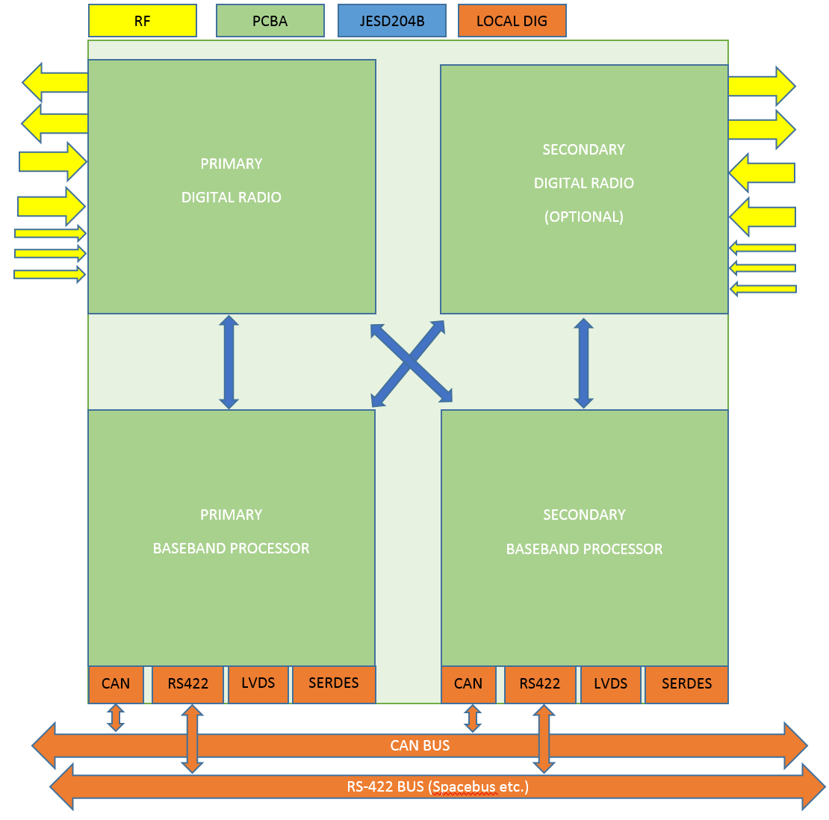
Physical Architecture

Slide 30
DVB-S2 Transmitter Block
Transmits Downlink BBFrames
Pulls Data From FIFO or Block Memory
ISOCHRONOUS (NBM) Has Priority
If No Full Frame Available – Dummy Frame is sent
Frames are always sent back to back – no gaps - ever
Symbol Rate is Fixed but may be changed from time to time. 80kbaud to 8Mbaud typical
Each Frame has MODCOD and Size (16k/64k)
Modulation QPSK, 8PSK always supported
Pilot Insertion (normally on in all cases)
APSK16/APSK32 with Linear Output Chains
FEC ¼,1/3, 1/2, ¾ 3/5, 4/5, 8/9, 9/10
Transmitter unaware of payload format

Slide 31
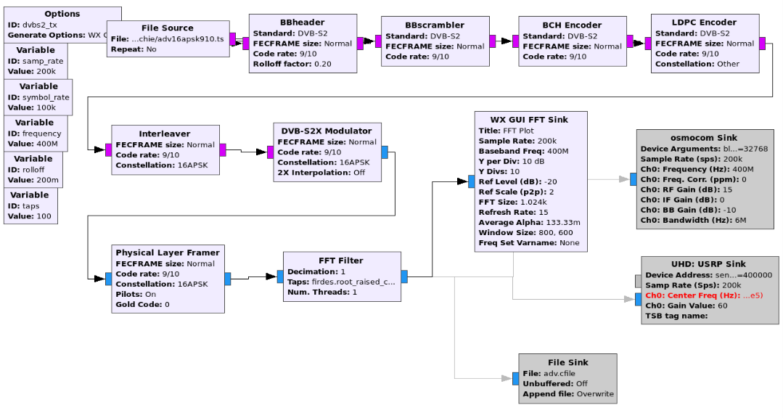
GR DVB-S2 Transmitter

Slide 32
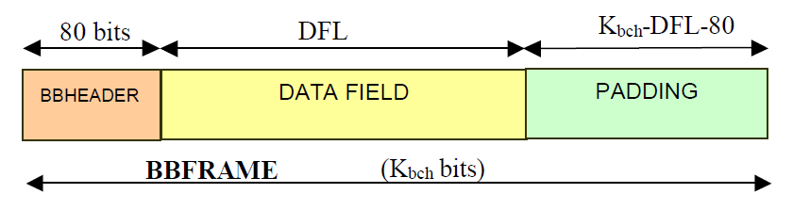
BBFRAME (BaseBand Frame) Not to be confused with IQ Baseband

Slide 33
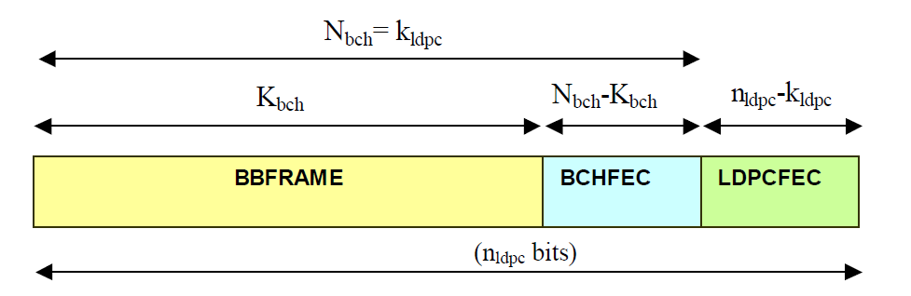
FEC FRAME

Slide 34
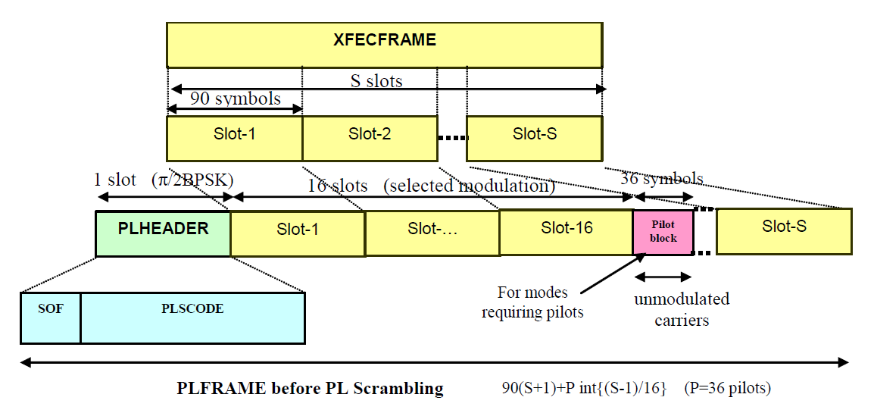
PLFRAME (Physical Layer)

Slide 35
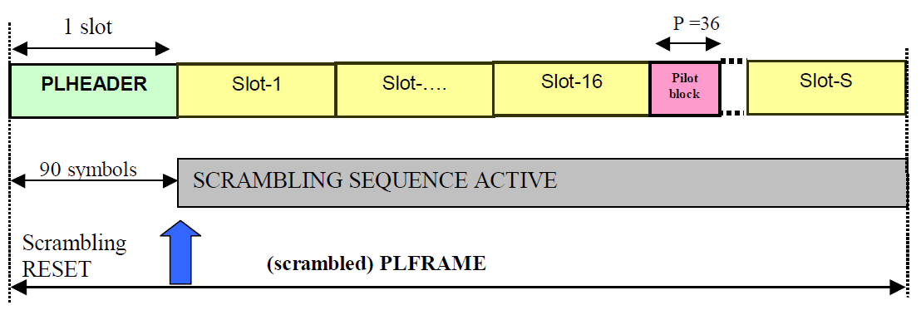
PL Scrambler

Slide 36
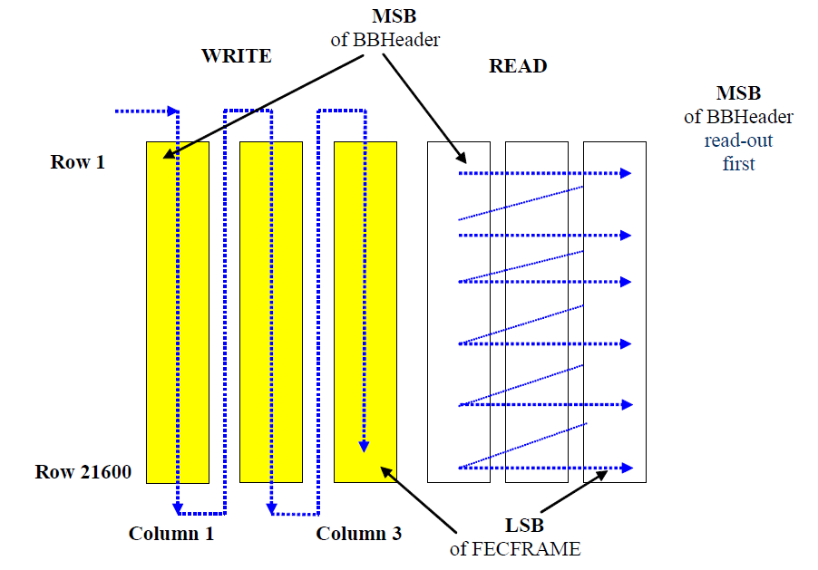
BIT INTERLEAVING (8PSK)

Slide 37
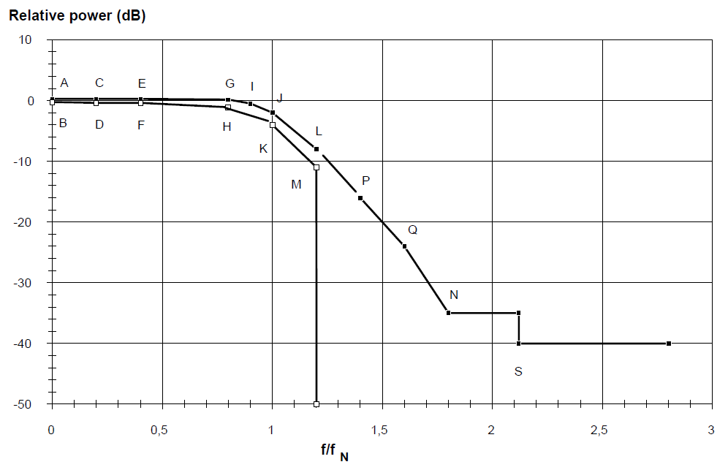
Rolloff (.35 Shown)

Slide 38
Major Functional Blocks
GSE Formatter
Formats Frames from Wideband Rcvr
NBM Frames have Priority
Wideband Channel per Stream
IP Packet Multiplexor
Formats IP Frames from Wideband Rcvr
NBM Frames have Priority
NARROWBAND Multiplexor
Combines low-bit rate channels
Isochronous 25 Frames Per Second
N x 800 bps channels
Compressed Voice and Data
Data Stuffed in silent intervals
Telemetry/Logs Stuffed in Idle Channels
Channel Acquisition Protocol
Runs in Narrowband Channels
Commissioning
Authenitcation
Authorization
Allocation
Narrow Band
Wideband Digital
Virtual Analog Channels

Slide 39
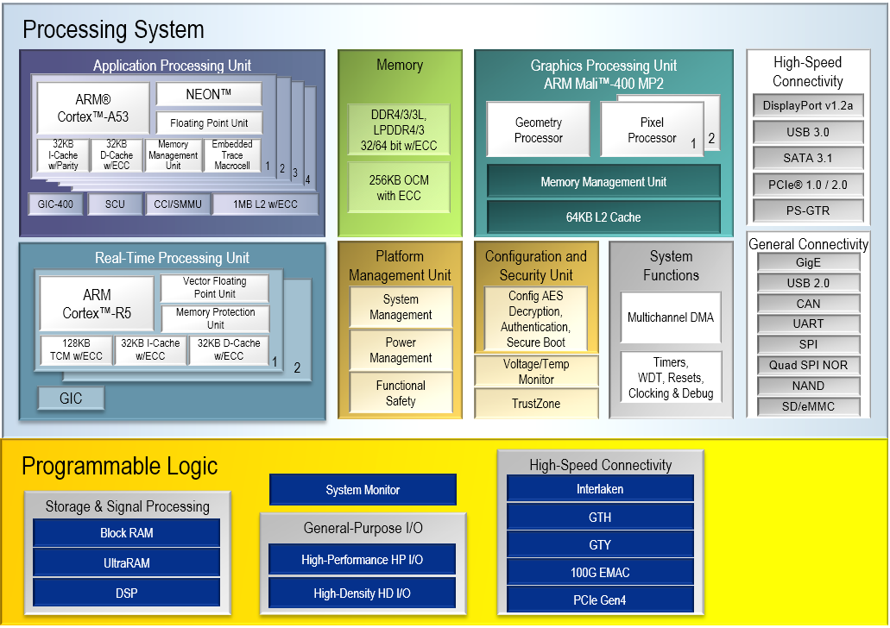
Zynq Ultrascale+ MPSoC (16nm)
Notes:
Processing System
PMU (Platform Management Unit)
Triple Redundant Microblaze (User Programmable)
CSU (Configuration and Security Unit)
Triple Redundant Microblaze (Not user accessible)
RPU (Dual Lockstep Cortex R5)
Dual Cortex R5 w/Vector FPU
Lockstep Capable
128KB TCM w/ECC/32KB I-Cache w/ECC /32KB D-Cache w/ECC Each
APU (Application Processing Unit)
Dual or Quad Core A53 with NEON and FPU
128KB TCM (Tightly Coupled Memory w/ECC
32KB I-Cache/32KB D-Cache
Vector Floating Point
Memory
256KB OCM (On-chip Memory) with ECC
External LPDDR4/3 32/64 bit wit ECC
GPU (ARM Mail)
Programmable Logic
489K Logic Cells/429K Flipflops, 1,973 DSP Slices,25Mb RAM

Slide 40
Top Level MPSoC Architecture
Processing System
PMU (Platform Management Unit)
Triple Redundant Microblaze (User Programmable)
CSU (Configuration and Security Unit)
Triple Redundant Microblaze (Not user accessible)
RPU (Dual Lockstep Cortex R5)
Dual Cortex R5 w/Vector FPU
Lockstep Capable
128KB TCM w/ECC/32KB I-Cache w/ECC /32KB D-Cache w/ECC Each
APU (Application Processing Unit)
Dual or Quad Core A53 with NEON and FPU
128KB TCM (Tightly Coupled Memory w/ECC
32KB I-Cache/32KB D-Cache
Vector Floating Point
Memory
256KB OCM (On-chip Memory) with ECC
External LPDDR4/3 32/64 bit wit ECC
GPU (ARM Mail)
Programmable Logic
489K Logic Cells/429K Flipflops, 1,973 DSP Slices,25Mb RAM

Slide 41
Processing System IO
High Speed
DisplayPort v1.2a
USB 3.0 (5 Gbs)
SATA 3.1 (6 Gbs)
PCIe 1.0/2.0
PS-GTR
General Connectivity
GigE
USB 2.0
CAN
UART
SPI
Quad SPI NOR
NAND
SD/eMMC

Slide 42
PL High Speed Connectivity
Interlaken
GTH Transceivers (16 Gbps)
GTY Transceivers (32 Gbps) – High End Devices Only
100G EMAC
PCIe Gen 4

Slide 43
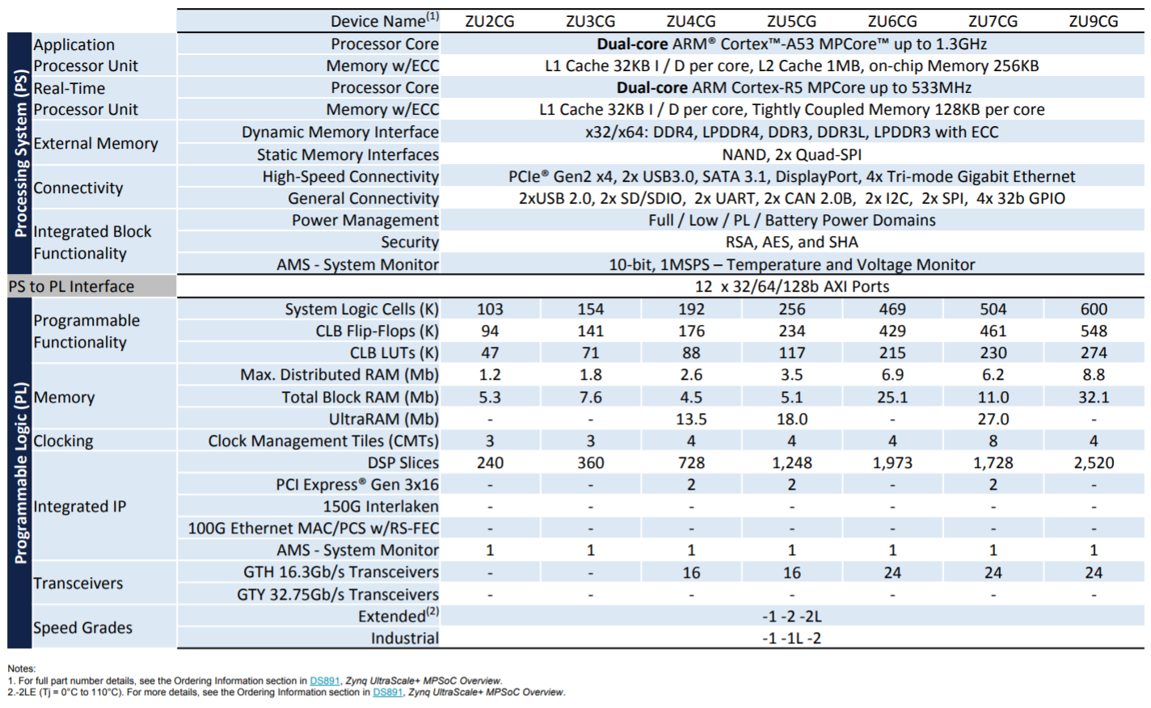
Ultrascale + MPSoC’s

Slide 44
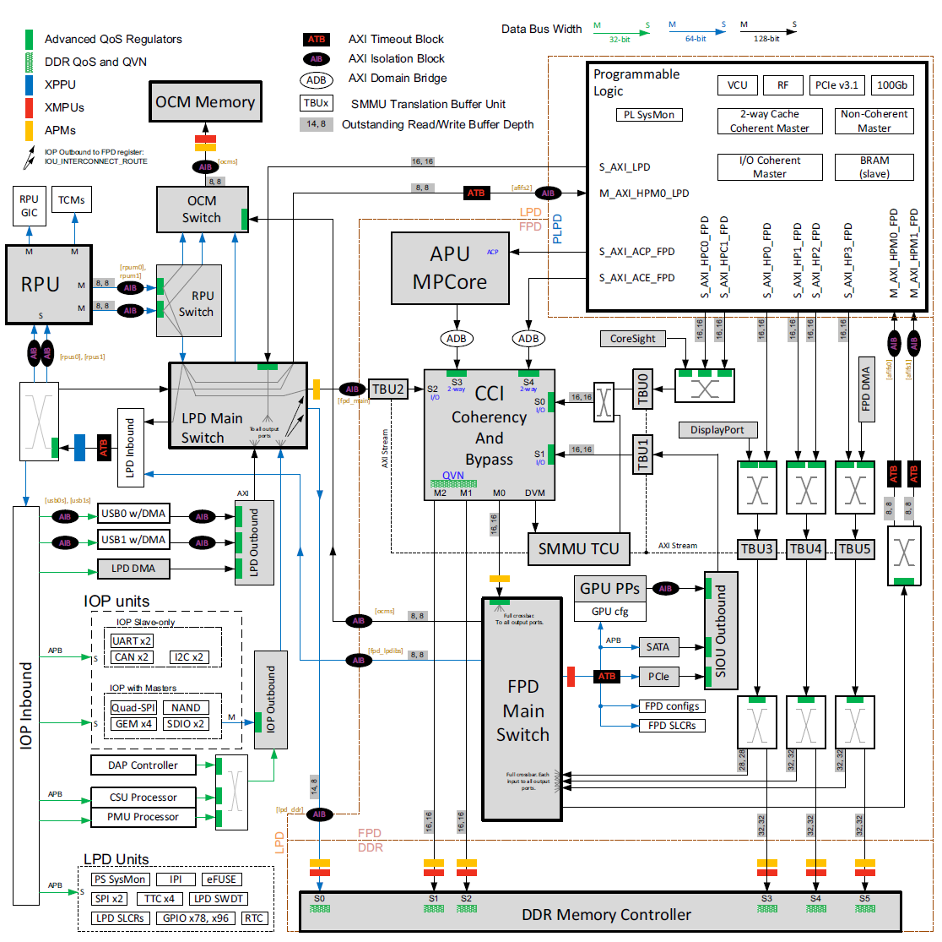
AXI Interconnects
Notes:
Advanced eXensible Interface – High Speed DMA Based Read and Write between SoC and FPGA Fabric

Slide 45
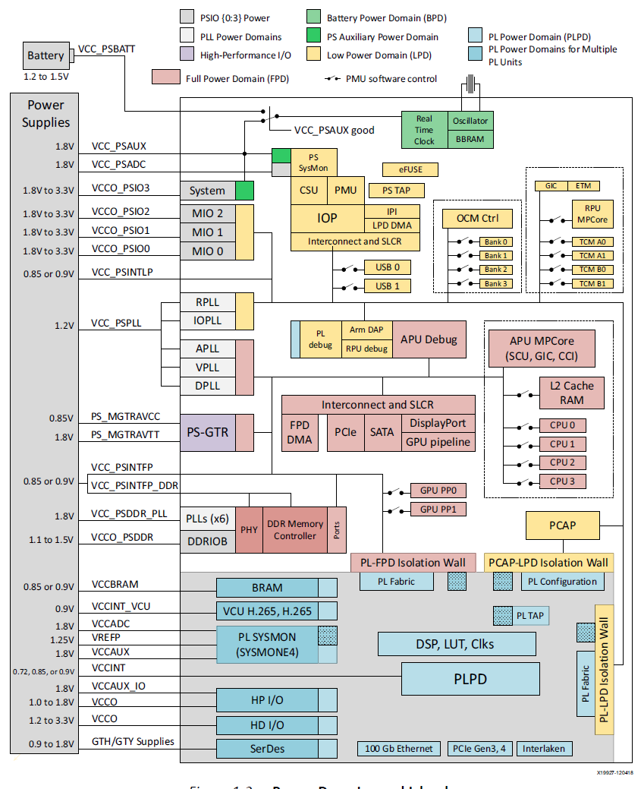
Power Domains and Islands

Slide 46
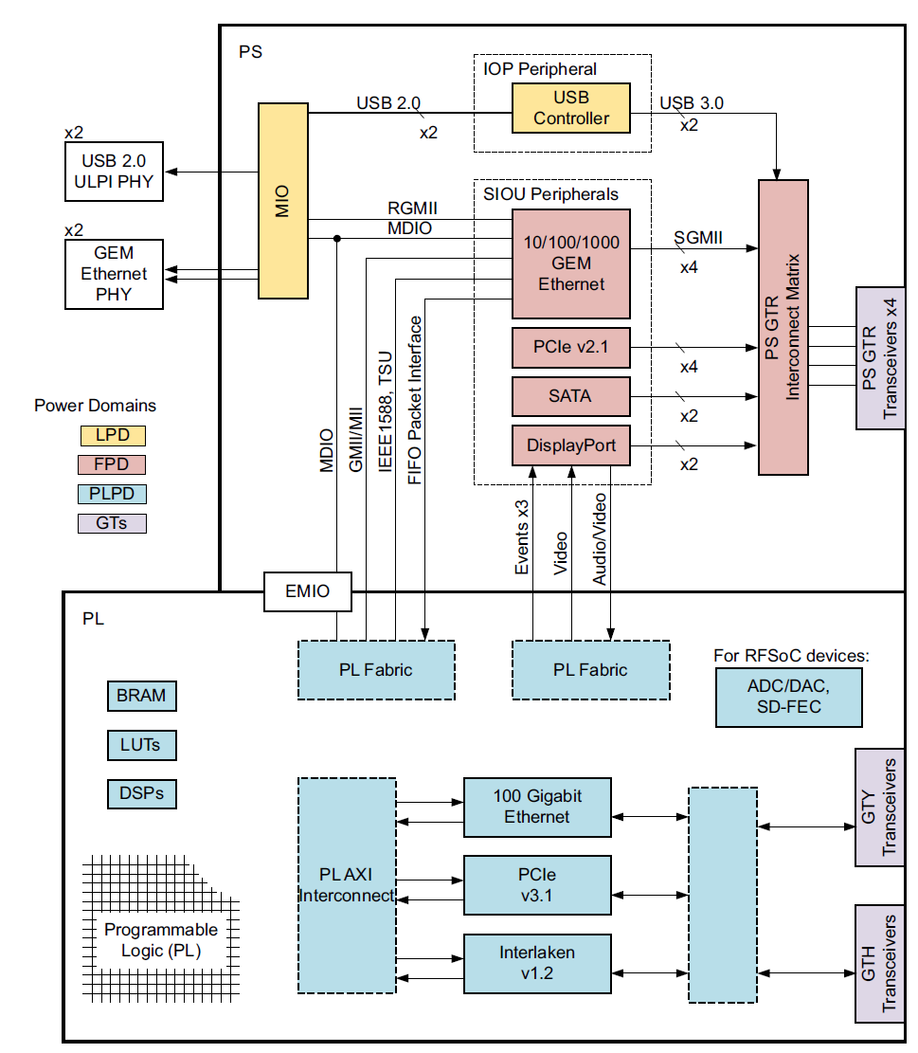
High Speed IO
Notes:
The 4 GTR Transceivers of the PS can be connected to any combination of the 14 lanes from the IOP or SIOU.

Slide 47
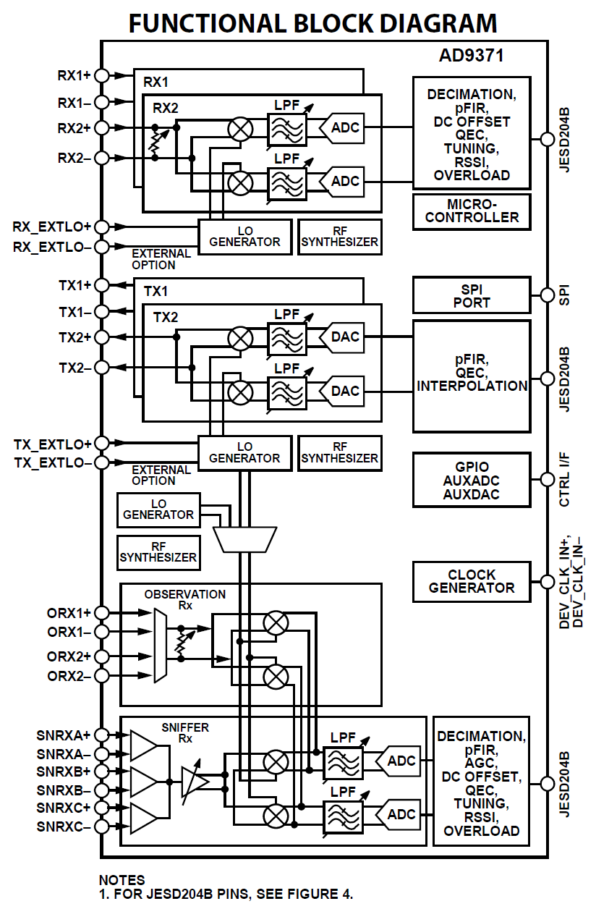

Slide 48
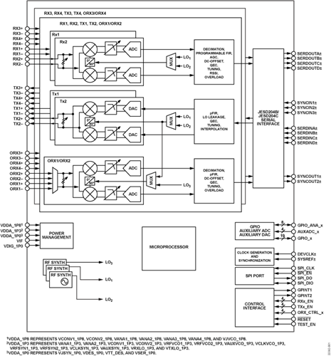

Slide 49
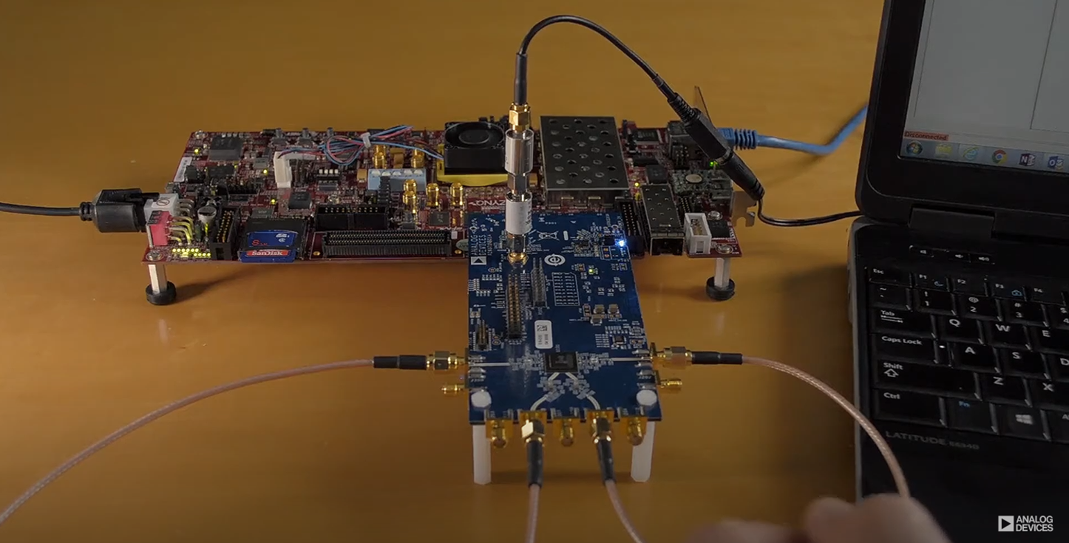
AD9371 Reference Platform

Slide 50
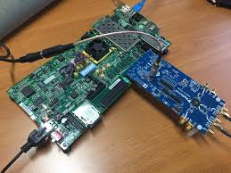
ADRV-9371/ZC706

Slide 51
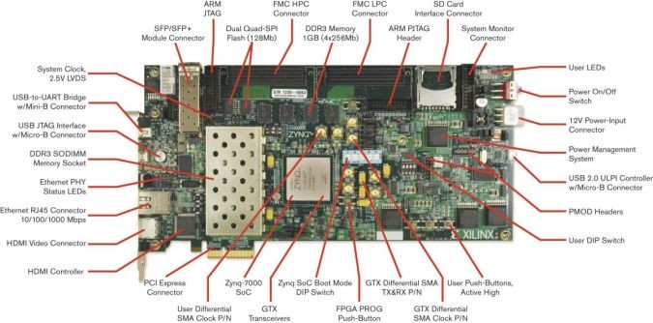
ZC706 EVALUATION BOARD

Slide 52
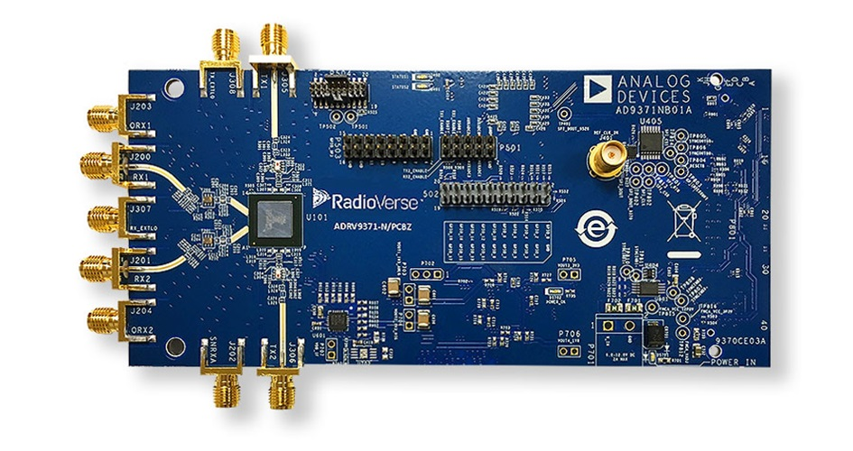
ADRV9371

Slide 53
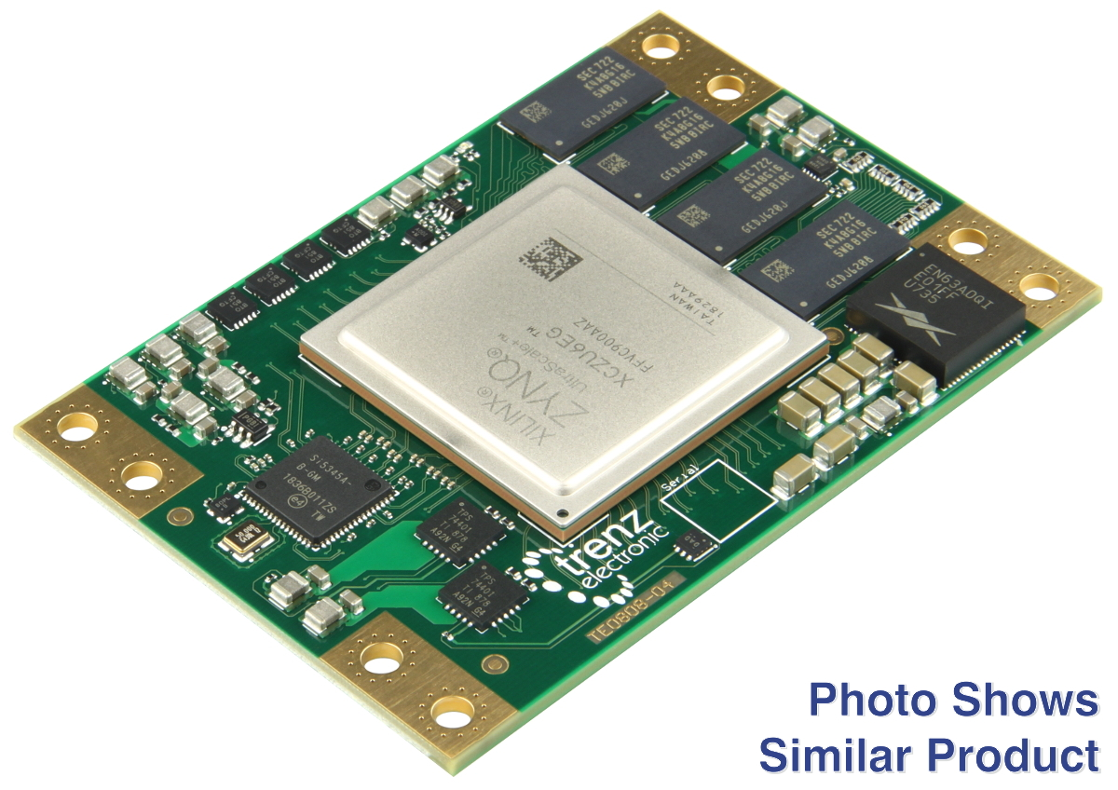
Trenz 76mm x 52mm Module

Slide 54
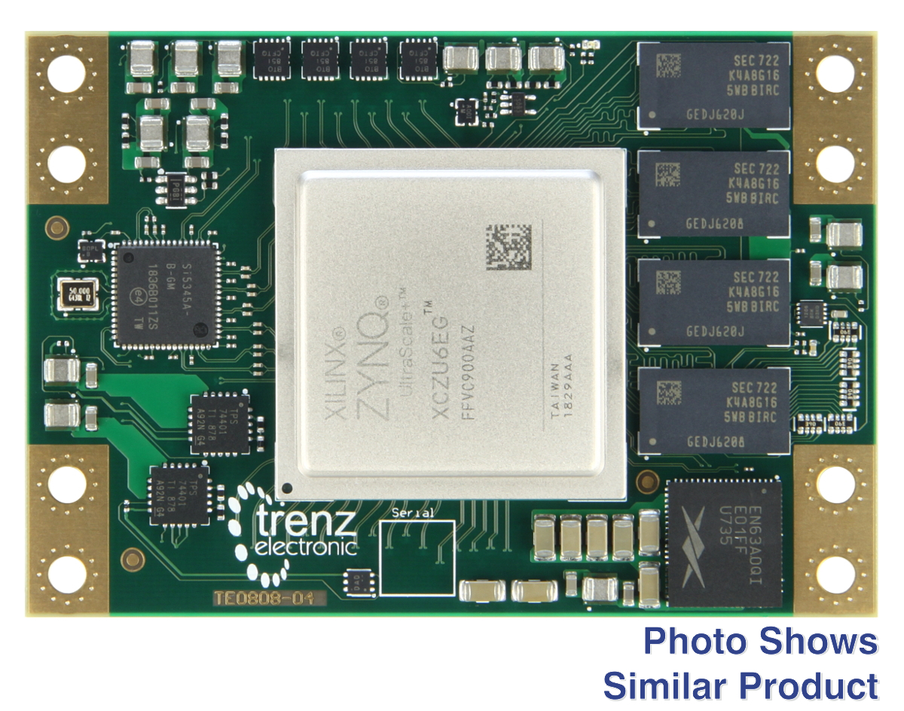
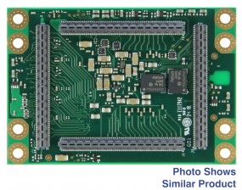
Trenz Ultrascale + Modules

Slide 55
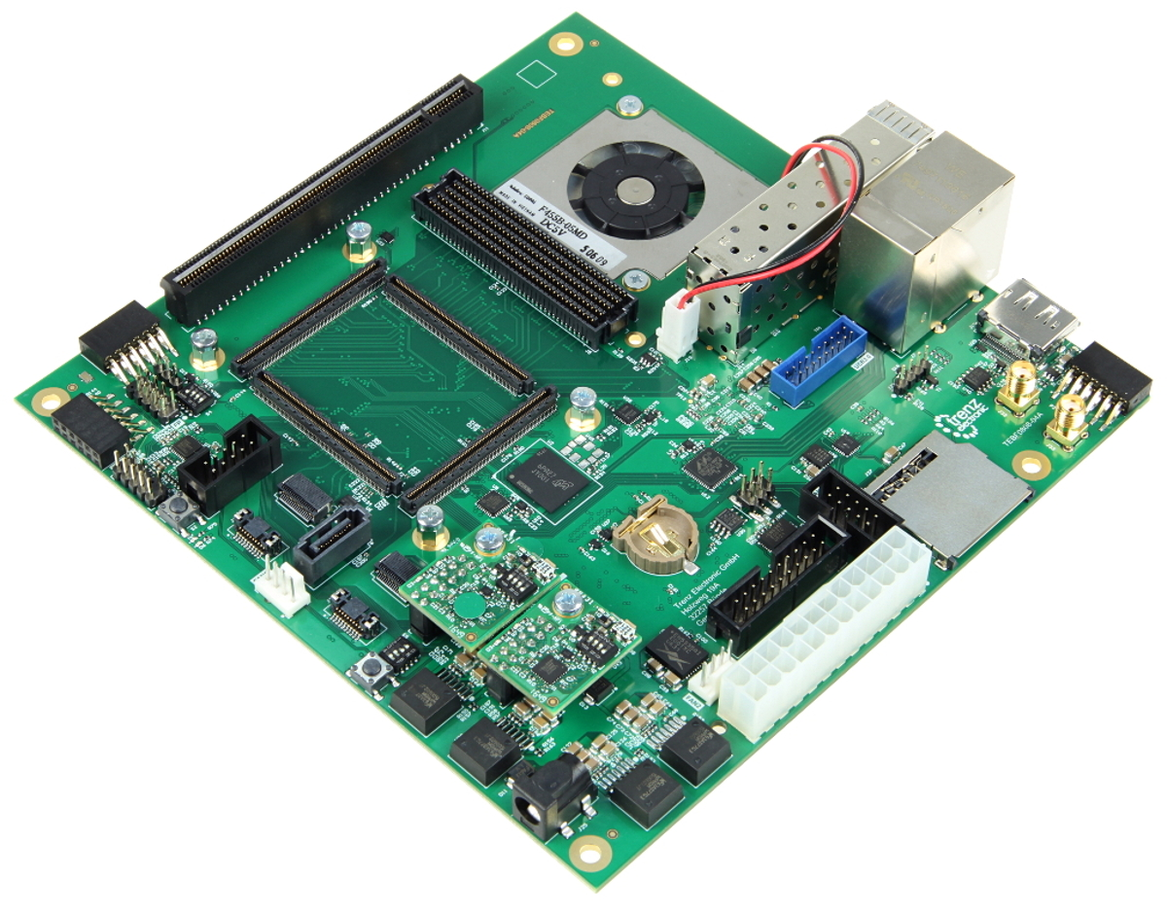
Trenz Carrier Board Mini iTX 17mm x 17mm

Slide 56
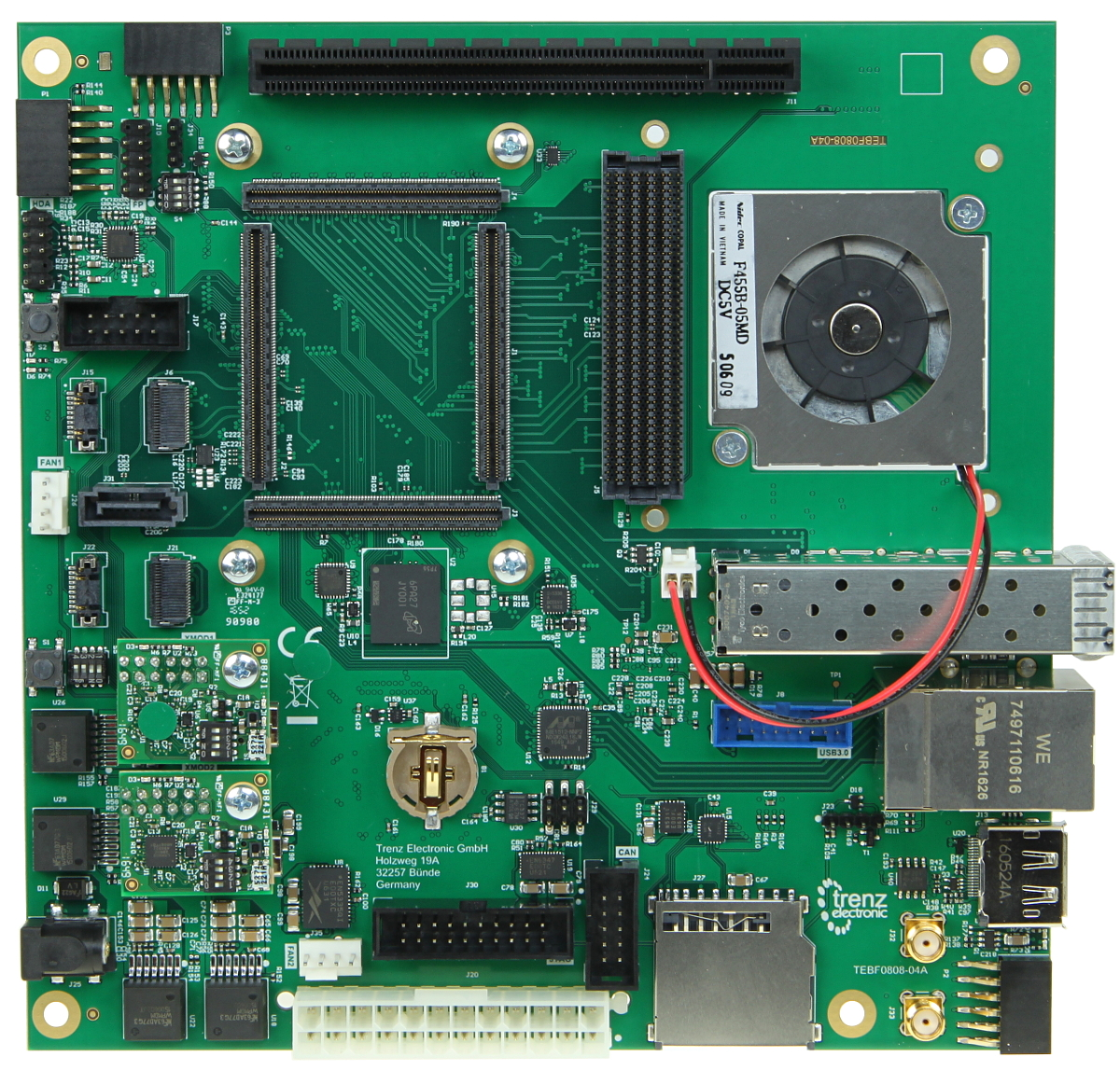
Trenz Carrier (Top)

Slide 57
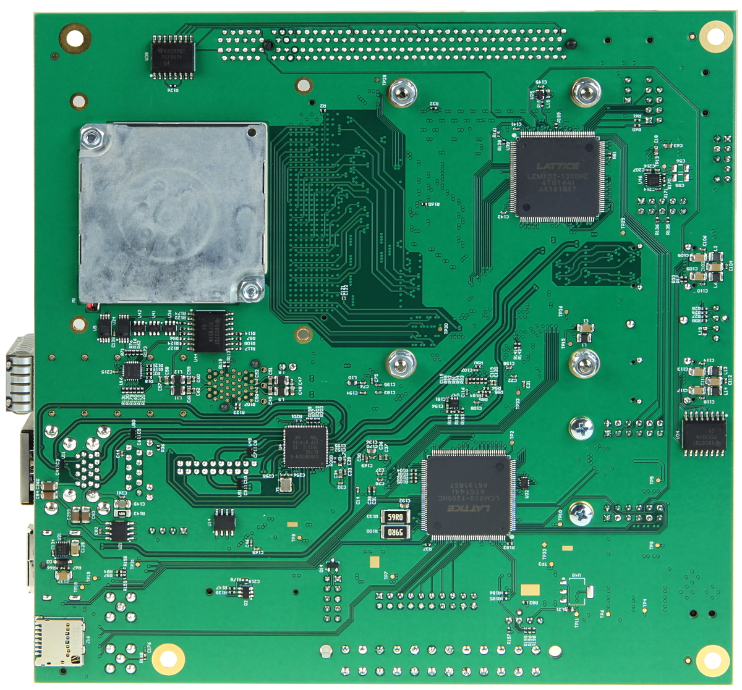
Trenz Carrier (Bottom)

Slide 58
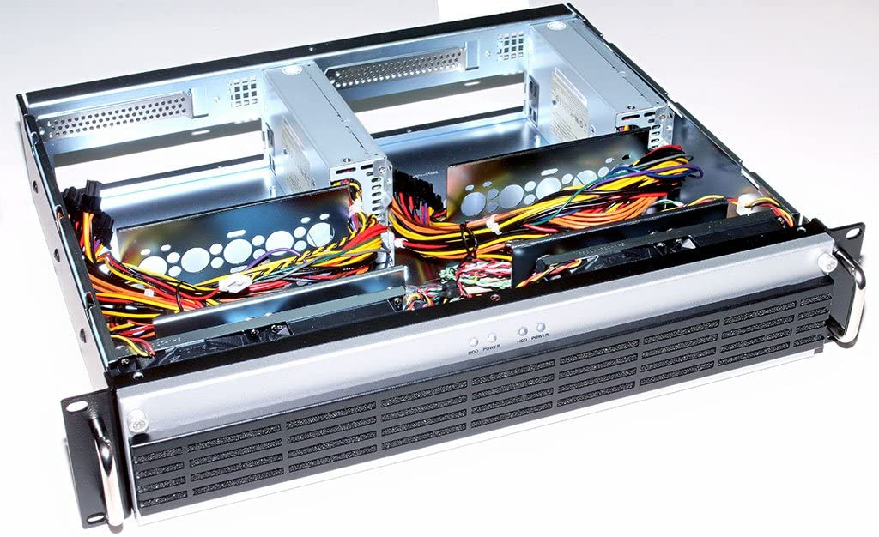
Dual Mini-Atx Rackmount

Slide 59
Documents
System Architecture Reference (Roadmap)
Downlink Specification
Narrowband Uplink Specification
Wideband Uplink Specification
Narrowband Multiplexor Specification
Application/Radio API

Slide 60
DMT TEAMS
Build/Integration Team (PMU/CSU)
RPU Team (Lockstep ARM-R5/RTEM
System Management
TT&C
APU Team (Dual/Quad ARM-A53 64-bit)
Authentication/Authorization/Access
Channel Access Protocol Controller
FPGA Team
DVB-S2 Transmitter
FRAMER
Narrowband Multiplexor
Wideband Multichannel Receiver (100kHz) x 32/64
Narrowband Multichannel Receiver (10kHz) x 128/256
RF Team
Digital Radio
Analog Chains
PCBA Team
Project Management

